Slide 1
Lecture 1 Introduction
Ran Cheng (程然)
https://chengran.tech/
https://emi.sustech.edu.cn/

Slide 2
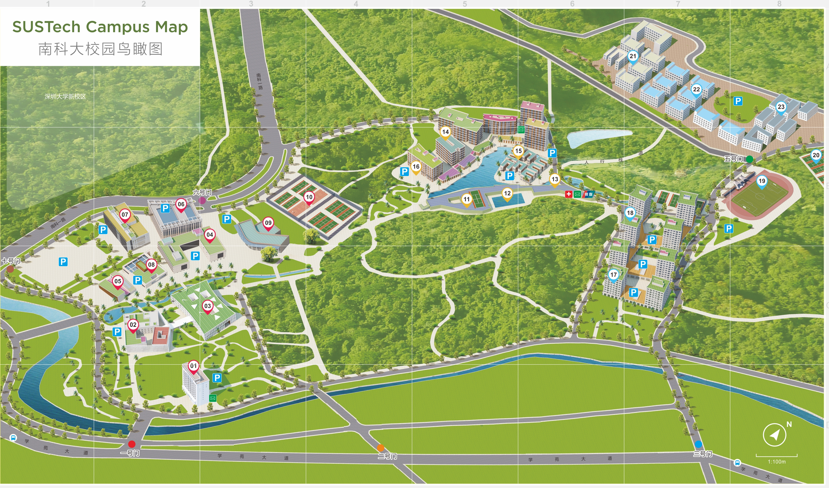


Real-world problems

Slide 3
Problem Solving
Example: a sorting problem
Sort a set of cards
Sort the student list according to scores
How would a human solve a problem?
Uses brain, hands
How would a computer solve a problem?
Uses CPU, memory
A series of operations: algorithms & data structures

Slide 4
Algorithm

Slide 5
What is an algorithm?
Algorithm: a well defined sequence of steps for solving a computational problem
It produces the correct output
It uses basic steps / defined operations
It finishes in finite time
Idea of a selection sort method
Start with empty hand, all cards on table
Pick the smallest card from table
Insert the card into the hand

Slide 6
Sorting algorithm
Example: selection sort algorithm
Input: an array A of n numbers
Output : an array A of n numbers in the ascending order
Selection-Sort ( A[1..n] )
1. for integer i ← 1 to n–1
2. k ← i
3. for integer j ← i+1 to n
4. if A[k] > A[j] then
5. k ← j
6. swap A[i] and A[k]
5 | 2 | 4 | 9 | 7
2 | 5 | 4 | 9 | 7
unsorted
2 | 4 | 5 | 9 | 7
unsorted

Slide 7
How algorithm solves a problem?
Real-world input
Problem definition
Input
Design algorithm
Program
Algorithm implementation
Output
Real-world output

Slide 8
Data structure
Algorithms depend on data structures

Slide 9


What is data structure?
set
Let S be a set of items, and x be a search key
A key is a number, e.g., product id
Useful operations on a set S
Search(S, x): search whether x appears in S
Insert(S, x): insert item x into S
Delete(S, x): remove item x from S
Data structure:
A way of organizing data objects for efficient usage
Building blocks for designing algorithms
3
8
7
2
search key
5

Slide 10
Why data structure?
You will learn them in this course …
Why so many data structures?
They support different operations, and with different time complexities
Which data structure is better?
Depends on the frequency of operations used in your algorithm
E.g., it is fast for the most frequent operation in your algorithm
Array
Linked List
Stack
Queue
Hash table
Heap
Tree
……

Slide 11
DSAA Demo
Find our classroom

Slide 12

Any idea?

Slide 13
(x₀, y₀)
Y
(x₂₁, y₂₁)
21
(x₂₂, y₂₂)
22
(x₂₃, y₂₃)
(x₁₃, y₁₃)
(x₁₄, y₁₄)
23
(x₁₂, y₁₂)
14
(x₁₆, y₁₆)
(x₇, y₇)
(x₁₀, y₁₀)
15
20
16
13
(x₂₀, y₂₀)
10
12
19
(x₆, y₆)
6
11
(x₁₈, y₁₈)
(x₁₉, y₁₉)
7
9
(x₉, y₉)
(x₁₁, y₁₁)
(x₁₅, y₁₅)
18
4
(x₈, y₈)
8
(x₅, y₅)
17
(x₁₇, y₁₇)
(x₄, y₄)
5
3
(x₂, y₂)
2
(x₃, y₃)
1
(x₁, y₁)
X

Slide 14
Y
if(xi==x0 && yi==y0)
“It is our classroom”
else
“It is not our classroom”
x₂₁== x₀ && y₂₁ == y₀
21
14
15
20
16
13
10
12
19
7
6
11
18
4
9
8
17
5
2
3
1
X

Slide 16
Left
Right
L0
L1
L2
R0
R1
R2
01,02,03
04,05,06,07,08
09,10
11,12,13,14,15,16
17,18
19,20,21,22,23

Slide 17
Tree data structure
Let S contain all tree nodes, and x denote our classroom
Useful operations on a set S
Children(S): find the children of S
Search(S, x): search whether x appears in S
Tree data structure:
A way of organizing data objects for efficient usage
Useful operations for designing algorithms

Slide 18
Algorithm Designs

Slide 19


Algorithm design techniques
Incremental technique
Build a solution into a larger solution
E.g., we have a sorted subarray A[1..i–1], then append an item to obtain a sorted subarray A[1..i]
Recursive technique (or divide-and-conquer)
Reduce the problem into smaller subproblems
E.g., find the smallest item in subarray A[i..n], then sort the subarray A[i+1..n]

Slide 20

Example: number guessing game
Rules
Host: pick a secret integer X from 1 to 20
Guest: guess V as the answer
→ Host: “V is too low” / “V is too high” / “V is correct!”
Simple strategy: test each integer in ascending order
Guess 1 → too low
Guess 2 → too low
……
Guess 19→ correct!
Can you suggest a more efficient strategy?
pick X=19

Slide 21
Divide-and-conquer Strategy
Guess the number game
Guess 10 → too low
[Think] Is X between 1 and 9? NO
[Think] Is X between 11 and 20? YES
Guess 15 → too low
[Think] Is X between 11 and 14? NO
[Think] Is X between 16 and 20? YES
Guess 18→ too low
Guess 19→ correct!
1 - 9
10
11 - 20
11 - 14
15
16 - 20

Slide 22
Binary Search
Definition:
Binary search is a search algorithm that finds the position of a target value within a sorted array. (Why sorted?)
Application:
Binary search can be used in a variety of applications, e.g., searching for an item in a database. (indexing)
Algorithm:
Binary search works by repeatedly dividing the search interval in half.

Slide 23
Binary Search
What is the procedure of the algorithm?
In your own language
In pseudo code
In programming code

Slide 24
Binary Search
Procedure in your own language:
Start with the middle element of the array.
If the middle element is the target value, return its index.
If the middle element is greater than the target value, search the left half of the array.
If the middle element is less than the target value, search the right half of the array.
Repeat the above steps until the target value is found or the search interval is empty.
If the target value is not found, return a failure message.

Slide 25
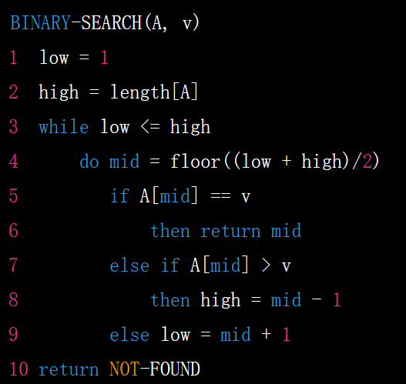
Binary Search
Procedure in pseudo code
Pseudocode is a high-level description of a computer program or algorithm that is intended to be understood by humans rather than executed by a computer.

Slide 26

Binary Search
Procedure in JAVA?

Slide 27
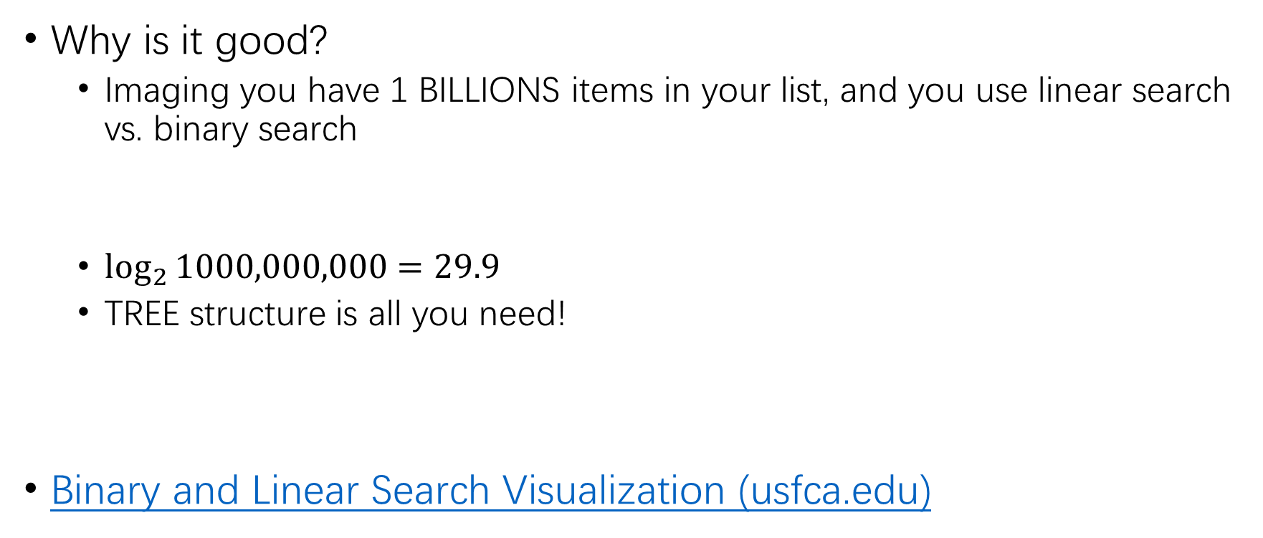
Binary Search
Why is it good?
Imaging you have 1 BILLIONS items in your list, and you use linear search vs. binary search
$\log_{2}{1000,000,000=29.9}$
TREE structure is all you need!
Binary and Linear Search Visualization (usfca.edu)

Slide 28
Recursive Technique

Slide 29
Iteration
When we encounter a problem that requires repetition, we often use iteration – i.e., some type of loop
Sample problem: printing the series of integers from n1 to n2, where n1 <= n2.
printSeries(1,8) should print the following
1, 2, 3, 4, 5, 6, 7, 8
Iterative solution:
public static void printSeries(int n1, int n2){
for(int i=n1; i<n2; i++)
System.out.print(i + ”, ”);
System.out.println(n2);
}

Slide 30


Recursion
Recursion is a programming technique where a function calls itself to solve a problem by breaking it down into smaller sub-problems.
Recursion is commonly used in data structures like trees and graphs, as well as in sorting and searching algorithms.

Slide 31

Recursion
The main character, Cobb, is a skilled extractor who enters people's dreams to steal their secrets.
In the movie, Cobb is given the task to plant an idea into a target's mind, a process known as "inception."
To achieve the goal, Cobb and his team have to enter multiple levels of dreams within dreams, each level nested within the previous one.
Each level of dream is constructed by a dreamer, with the dreams becoming more unstable and dangerous as they go deeper.

Slide 32
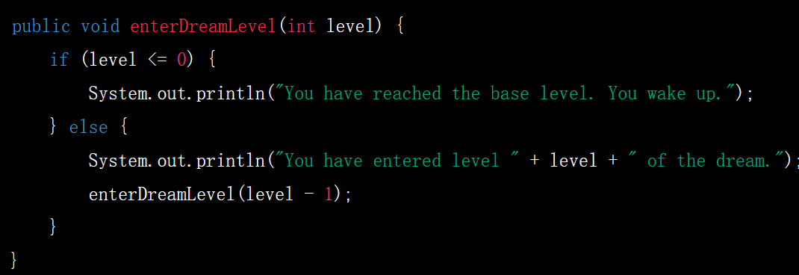
Recursion
Pseudo code to describe the logics of the movie?
Dreaming a dream in a dream.

Slide 33
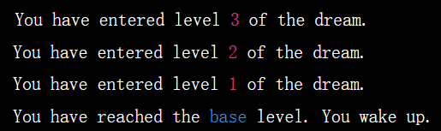
Recursion
What happens with enterDreamLevel(3)?

Slide 34
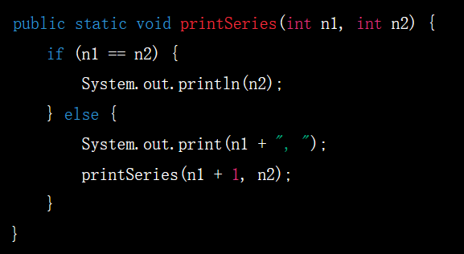
Recursion
An alternative approach to problems that require repetition is to solve them using recursion
A recursive method is a method that calls itself
Applying this approach to the printSeries problem:

Slide 35
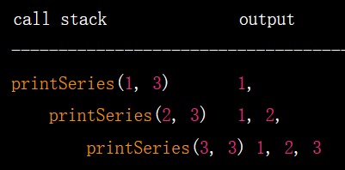
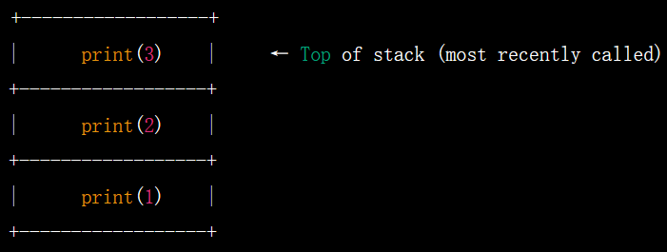
Recursion
What happens with recursion?
When we execute printSeries(1,3):
A call stack is a data structure used by a program to keep track of active subroutines, or functions, during their execution.

Slide 36
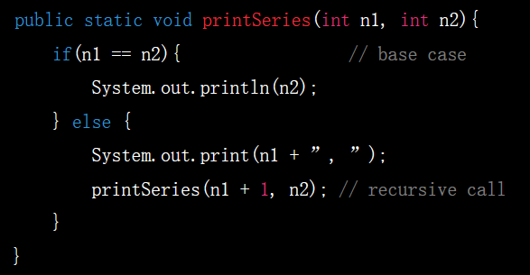
Recursive problem-solving
When we use recursion, we solve a problem by reducing it to a simpler problem of the same kind
We keep doing this until we reach a problem that is simple enough to be solved directly.
The simplest problem is known as the base case

Slide 37
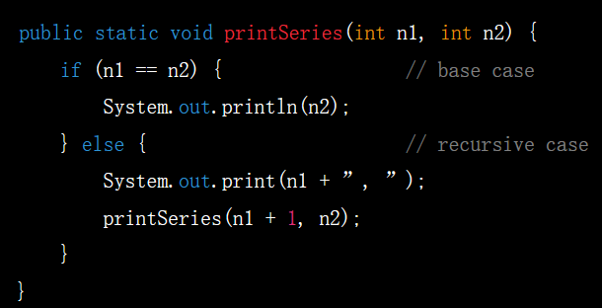
Recursive problem-solving
If the base case has not been reached, we execute the recursive case
The recursive case:
Reduces the overall problem to one or more simpler problems of the same kind
Makes recursive calls to solve the simpler problems.

Slide 38
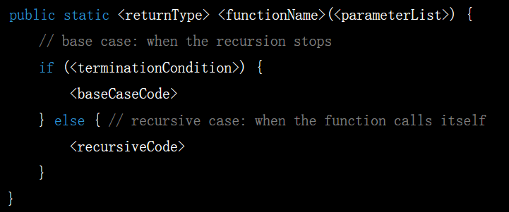
Template of recursive method
There can be multiple base cases and recursive cases
When we make the recursive call, we typically use parameters that bring us closer to a base case

Slide 39
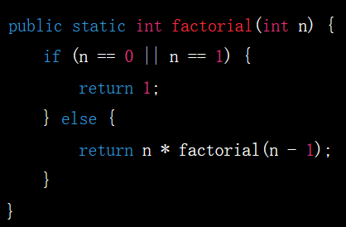
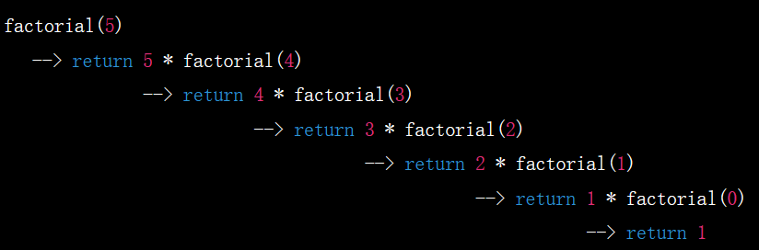
Example: Factorial (累乘)
Factorial (written as 5!) is equal to: 5 x 4 x 3 x 2 x 1 = 120.
Can you write a recursion function for it?
public static int factorial(int n) { …}

Slide 40
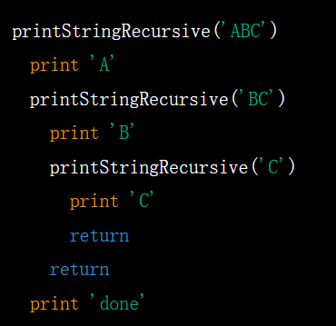
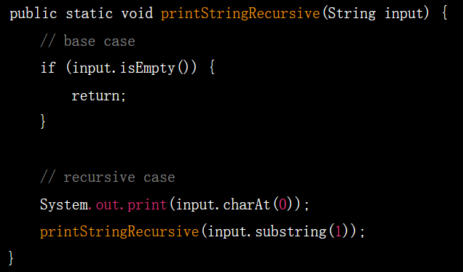
Example: printing a string
public static void printFileRecursive(String input) {…}

Slide 41
Think RECURSIVELY!
When solving a problem using recursion, ask yourself these questions:
How can I break this problem down into one or more smaller subproblems?
Make recursive method calls to solve the subproblems
What are the base cases?
i.e., which subproblems are small enough to solve directly?

Slide 42
Thank you

